Slide 1
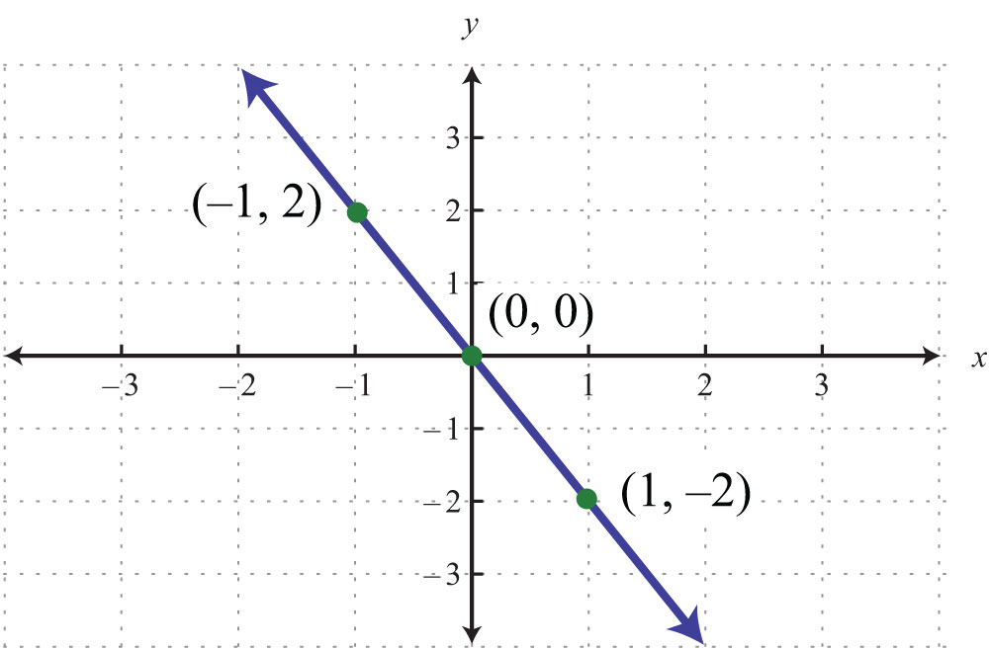
WARM Up
Find the slope of each of the following:
1.
2. Given
(14,-7) and (10,8)
3. Find the slope of the line.
$$Y=−x−1$$

Slide 2
Standard Form
Is x and y on the same side of the equal sign? If not add or subtract in order to get both on the same side
Is the coefficient with x positive? If not multiply/divide each term by -1
Is the coefficients integers (positive or negative whole number) if not multiply each team by the denominator that makes the coefficients integers.
Do the coefficients have a greatest common factor of 1? If not divide each term by the greatest common factor.

Slide 3
Ax+By=C
$y=2x+3$
$\frac{1}{2}x+\frac{1}{2}y=3$
0.5x=2

Slide 4
Slope-intercept form y=mx+b
m=$\frac{{(y}_{2}−y_{1})}{(x_{2}−x_{1}) }$
Slope of a graph $\frac{Rise}{Run}$

Slide 5
Closure
Find the slope of the following:
(-3,1),(-17,2)
5x+2y=6

