Slide 1
2.7 Day 2 Graphing Absolute Value Inequalities
Get out your notes and purple sheet and get ready for a Warm-Up!

Slide 2
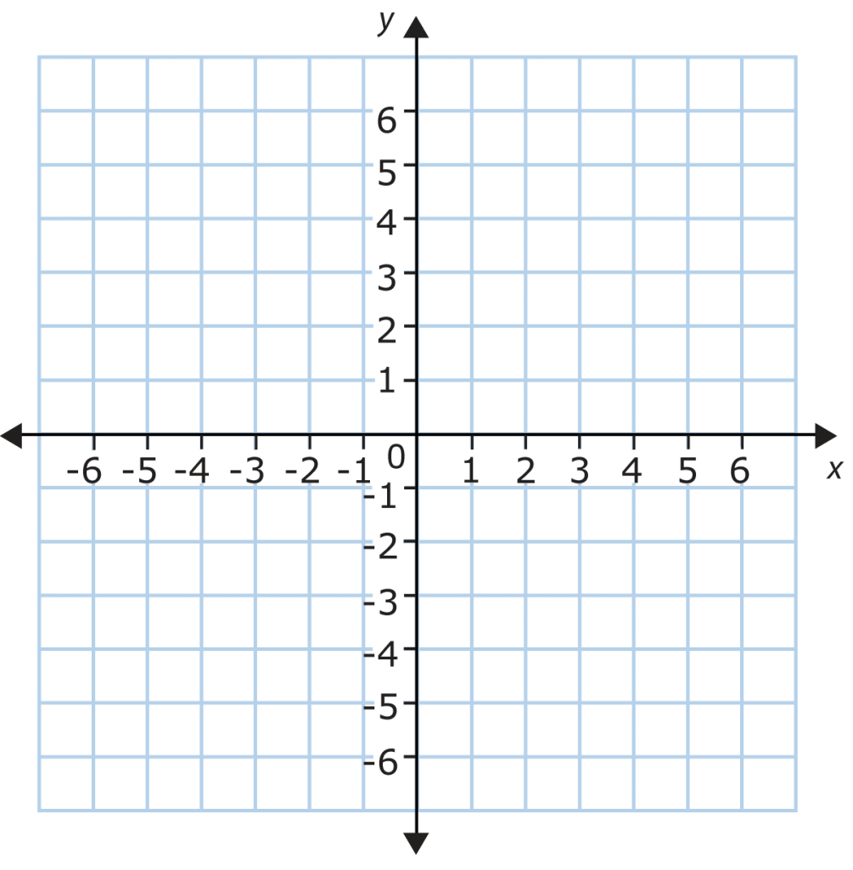

Warm-Up
Sketch the graph of $y+\left|x\right|<3$.
(Hint: get y by itself on the right first)

Slide 3
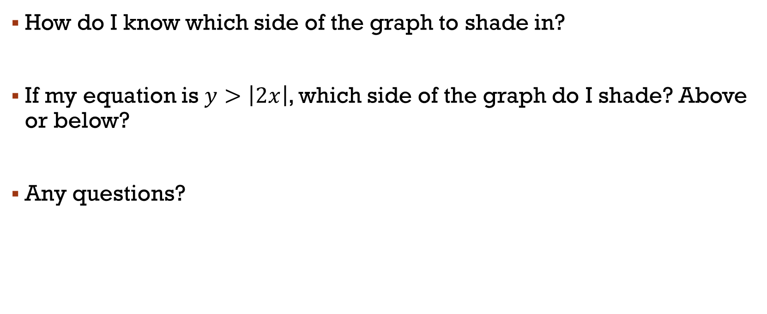
Survey Questions
How do I know which side of the graph to shade in?
If my equation is $y>\left|2x\right|$, which side of the graph do I shade? Above or below?
Any questions?

Slide 4
Remember
≤ or ≥ means that we use a solid line
< or > means that we use a dashed line
< or ≤ shade below
> or ≥ shade above

Slide 5

Closure
Sketch the graph of $y≥\left|x−1\right|−2$
(Remember: $y=a\left|x−h\right|+k$)

