Slide 1
3.2 Day 2 Solving Systems of Equations by Elimination
Get out your notes and your purple sheets and get ready for a Warm-Up!

Slide 2
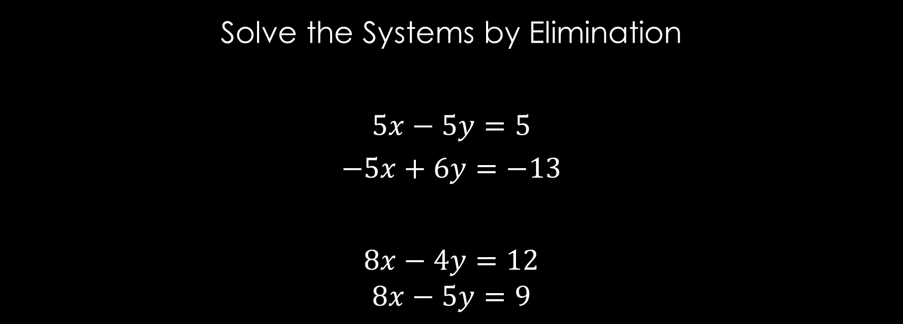
Warm-Up
Solve the Systems by Elimination
$$5x−5y=5$$
$$−5x+6y=−13$$
$$8x−4y=12$$
$$8x−5y=9$$

Slide 3
Elimination with Multiplication
Solve the System of Equations with Multiplication
$$−3x−3y=12$$
$$−4x+9y=16$$

Slide 4
Elimination with Multiplication Continued…
Solve the System of Equations with Multiplication
$$−2x−7y=15$$
$$3x+3y=0$$

Slide 5
REMEMBER!
If the variables add to zero, and the final statement is TRUE, then INFINITE SOLUTIONS.
If the variables add to zero, and the final statement is FALSE, then NO SOLUTION.

Slide 6
Ladder Activity
Complete the problems with your partner.
Once you are finished, bring one of your GradeCam sheets to me to be scanned.
If all the answers are correct, you can move on to the next set. If not, find your mistake and try again.
You are finished when you have completed all 5 sets of problems.

Slide 7
Closure
Solve the System by Elimination with Multiplication
$$8x−4y=8$$
$$−16x+8y=−16$$

