Slide 1
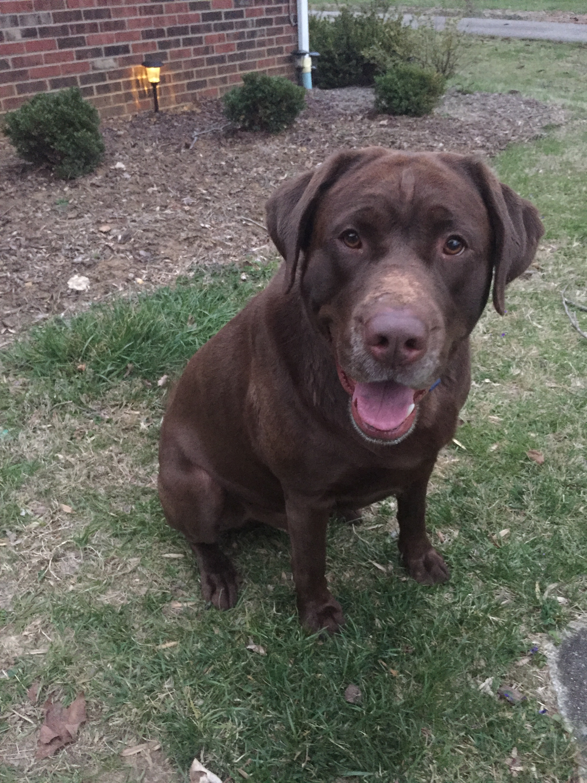
Happy (belated) national Puppy day to chipper!!!

Slide 2

Warm UP
Learning Target: I will simplify rational expressions using addition and subtraction
$\frac{2x}{3}÷\frac{4}{12}$
$\frac{(n−4)(n+7)}{(n−4)}∙\frac{(n+8)}{(n+7)(n−2)}$

Slide 3

$$\frac{4}{6}−\frac{2u}{3v}$$
Learning Target: I will simplify rational expressions using addition and subtraction

Slide 4

$$\frac{3}{m+2}+\frac{2m}{5m−6}$$
Learning Target: I will simplify rational expressions using addition and subtraction

Slide 5

Closure
$\frac{2x}{(x−2)}+\frac{8}{x}$
Learning Target: I will simplify rational expressions using addition and subtraction

