Slide 1
Warm up:
f(x)=(x+7)-3x+2
f(4)
f(h)
2f(x)

Slide 2
Classwork
All members of the group must answer problems
Do NOT move on until your answers have been checked. Please raise your hand when you have answered all the questions.

Slide 3
Classwork: pg 60
17-22 Get your answers checked after 22
24-32 evens get your answers checked after 32
46-51 Get your answers checked after 51
38-41 Get your answers checked after 41
35-37 Get your answers checked after 37

Slide 4
What if I ask g(2)+g(-3)?
For g(x)=3x-5
g(2)=3(2)-5=6-5=1
g(-3)=3(-3)-5=-9-5=-14
g(2)+g(-3)=1+-14=-13

Slide 5
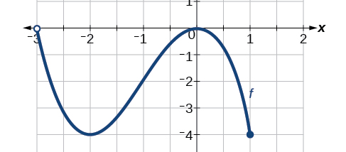
Domain- how far left and how far right
Domain: (-3,1]

Slide 6
Range- how far down and how far up
Range: [-4,0)

Slide 7
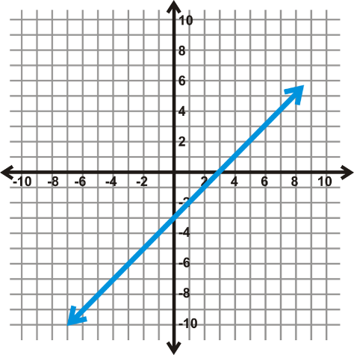
Domain and Range?
Domain: All Real Numbers Range: All Real Numbers

Slide 8
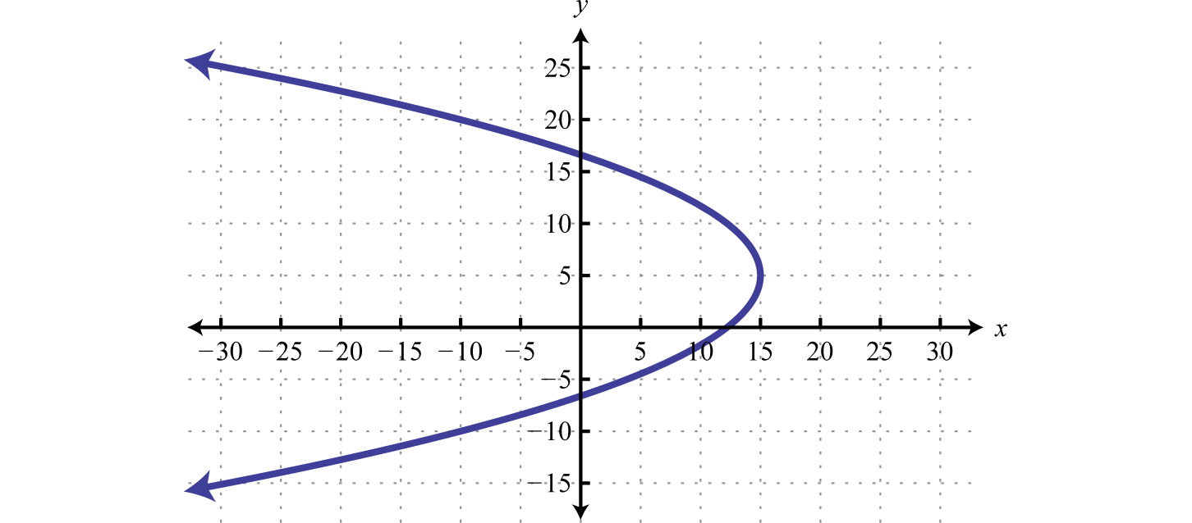
Domain and Range
Domain: (-inf,15] Range: All Real numbers

Slide 9
Domain and Range Worksheet

Slide 10
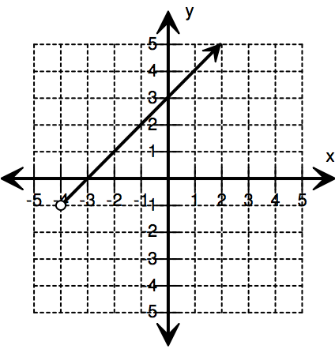
Closure:

Slide 11
Homework:
Mspehlke.weebly.com
Watch video under chapter 2 on linear equations
Notes should include examples definitions and survey questions

