Slide 1
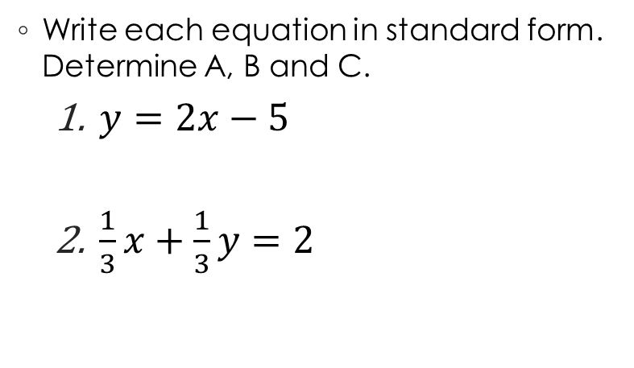
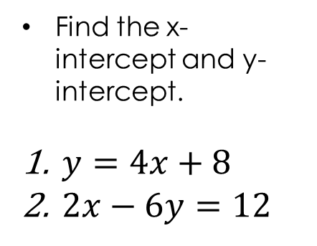
Warm Up
Determine if the equations are linear:
$y=x^{2}+3$
$y=17x−4$
Write each equation in standard form. Determine A, B and C.
$y=2x−5$
$\frac{1}{3}x+\frac{1}{3}y=2$
Find the x-intercept and y-intercept.
$y=4x+8$
$2x−6y=12$

Slide 2
Survey Questions
What is an example of a linear equation?
How do you find the x-intercept? How do you find the y-intercept?
How do you graph a linear equation using x and y intercept
Come up with one question about linear equation you might have.

Slide 3
Pretest:

Slide 4
When finished begin linear equation worksheet on your own!

Slide 5
Closure:
Determine if the equation is linear, write the equation in standard form and find the x and y intercept.
y=4x-2

