Slide 1

Warm up
Simplify
${\left(2−i\right)}^{2}$
$\frac{5}{2+i}$

Slide 2
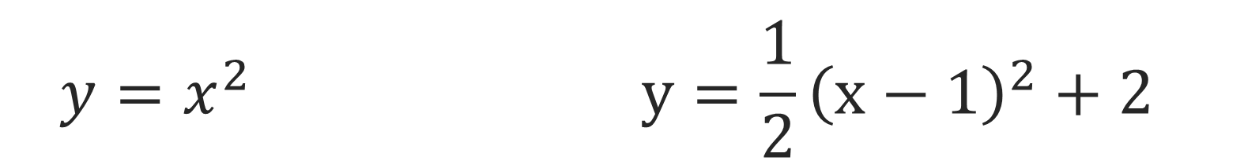
$$y=x^{2} y=\frac{1}{2}{\left(x−1\right)}^{2}+2$$

Slide 3
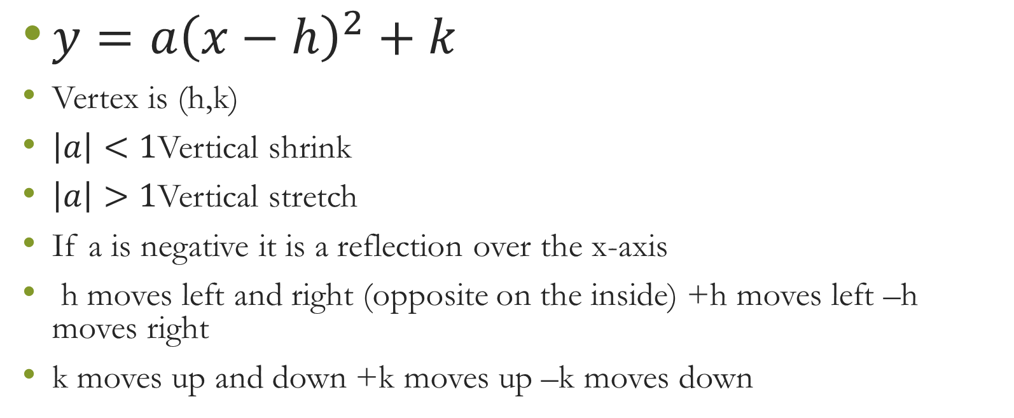
Vertex form
$y=a{\left(x−h\right)}^{2}+k$
Vertex is (h,k)
$\left|a\right|<1$Vertical shrink
$\left|a\right|>1$Vertical stretch
If a is negative it is a reflection over the x-axis
h moves left and right (opposite on the inside) +h moves left –h moves right
k moves up and down +k moves up –k moves down

Slide 4
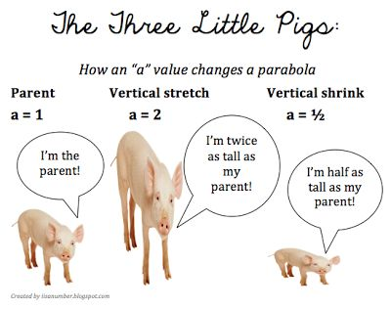

Slide 5

$$y=−2{\left(x−2\right)}^{2}+3$$
Vertex (2,3)
Axis of symmetry x=2
Opens down, max
Transformations: right 2, up 3, vertical stretch, reflection over the x axis

Slide 6

Closure
Determine the vertex, axis of symmetry and the transformation
  $f\left(x\right)=−{\left(x+2\right)}^{2}−3$

