Slide 1

Warm Up:
Learning Target: I will determine specific numbers in arithmetic and geometric sequences.
Determine the next 3 terms:
$−2,0,2,4,6…$
$3,6,12,24…$

Slide 2
Arithmetic and Geometric Sequences
Learning Target: I will determine specific numbers in arithmetic and geometric sequences.

Slide 3
VOCABULARY!
Sequence
Term (n)
a_{n}
a₁
A set, or list, of numbers that are in a specific order
Each individual value in a sequence
“a sub n” A specific term that you are trying to find
“a sub one” The first term in a sequence
Learning Target: I will determine specific numbers in arithmetic and geometric sequences.

Slide 4
Arithmetic Sequences
Very similar to linear functions
You are looking for the values to have a constant rate of change which is called the common difference expressed by “d”
a_{n} = a₁+(n-1)d

Slide 5
Arithmetic Sequences Example #1
First thing, define your terms…
1
2
3
4
-32, -2, 28, 58…
Next identify the common difference (d)…
Now, write the Equation…
a_{n} = a₁+(n-1)d
+30
+30
a_{n} = -32+(n-1)(30)
a_{n} = -32+30n - 30
a_{n} =
30n
- 62

Slide 6
Example #1 … Finding a specific term!
1
2
3
4
-32, -2, 28, 58…
Now find a₁₀
a₁₀ =
a₁₀ = 238
5 6 7 8 9 10
… 88, 118, 148, 178, 208, 238

Slide 7
Arithmetic Sequences Example #1 Continued…
1
2
3
4
-32, -2, 28, 58…
Now find a₁₀
a_{n} =
- 62
30n
a₁₀ = 300 - 62
a₁₀ = 30 (10) - 62
a₁₀ = 238

Slide 8
Arithmetic Sequences Example #2
First thing, define your terms…
1
2
3
4
8.1, 5.8, 3.5, 1.2…
Next identify the common difference (d)…
Now, write the Equation…
a_{n} = a₁+(n-1)d
-2.3
-2.3
a_{n} = 8.1+(n-1)(-2.3)
a_{n} = 8.1 -2.3n + 2.3
a_{n} =
-2.3n
+ 10.4

Slide 9
Arithmetic Sequences Example #2 Continued…
1
2
3
4
8.1, 5.8, 3.5, 1.2…
Now find a₂₃
a_{n} =
-2.3n
+ 10.4
a₂₃ = -52.9 + 10.4
a₂₃ = -2.3(23) + 10.4
a₂₃ = -42.5

Slide 10
Geometric Sequences
Very similar to exponential functions
You are looking for the values to have a rate of change, just not constant, which is called the common ratio expressed by an “r”
a_{n} = a₁ · r^{n-1}

Slide 11
Geometric Sequences Example #3
1
2
3
4
First thing, define your terms…
1.5, 0.3, 0.06, 0.012
Next identify the common ratio (r)…
x 0.2
Now, write the Equation…
x0.2
a_{n} = a₁▪r^{n-1}
a_{n} = 1.5▪0.2^{n-1}
a_{n} =
1.5▪0.2^{n-1}

Slide 12
Geometric Sequences Example #3 Continued…
1
2
3
4
1.5, 0.3, 0.06, 0.012
Now find a₈
a_{n} =
1.5 ·
0.2^{n-1}
a₈ = 1.5 · 0.0000128
a₈ = 1.5 · 0.2⁷
a₈ = 0.0000192

Slide 13
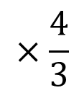
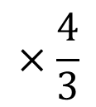
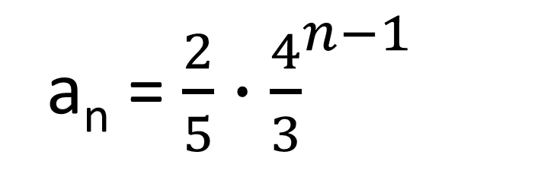
Geometric Sequences Example #3
1
2
3
4
First thing, define your terms…
$\frac{2}{5}, \frac{8}{15}, \frac{32}{45}, \frac{128}{135}$
Next identify the common ratio (r)…
Now, write the Equation…
$$×\frac{4}{3}$$
$$×\frac{4}{3}$$
a_{n} = a₁▪r^{n-1}
a_{n} = $\frac{2}{5}∙{\frac{4}{3}}^{n−1}$

Slide 14
Closure:
Learning Target: I will determine specific numbers in arithmetic and geometric sequences.
Determine the 14th term of
-9,-6,-3,0,3…

