Slide 1
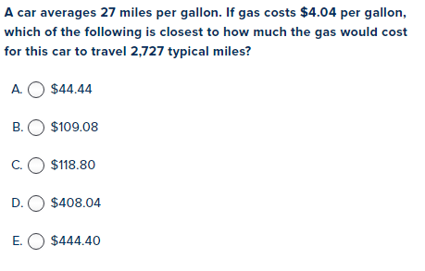
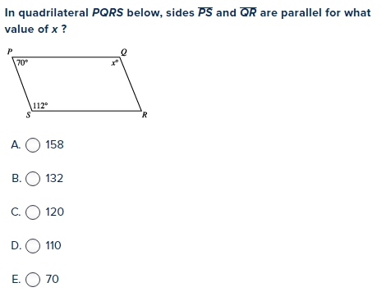
Warm-Up
LT: I can write the equation of a circle from a given radius and center coordinates.

Slide 2
Circles
LT: I can write the equation of a circle from a given radius and center coordinates.
Standard Form:
$${\left(x−h\right)}^{2}+{\left(y−k\right)}^{2}=r^{2}$$
$\left(h,k\right)$ is the center of the circle and $r$ is the radius

Slide 3
Examples
LT: I can write the equation of a circle from a given radius and center coordinates.
Using the information given, write the standard equation of the circle described.
Center: (-7, -1), Radius: 9
Center: (11, 5), Radius: 5

