Slide 1
Get out your purple paper and get ready for the warm up
I will be able to convert between slope-intercept, point-slop and standard form of a linear equation.

Slide 2

Warm up:
Write $y=7x+6$ in standard form.
Write $y=5x−8$ in point slope form.
Write $y−3=2(x−4)$in slope intercept form

Slide 3
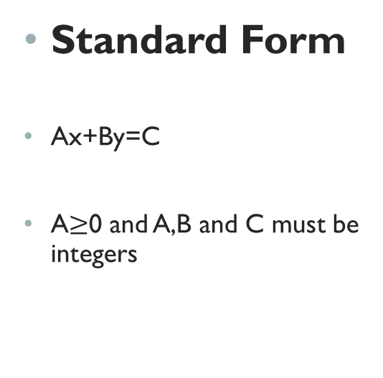
Remember!!
Standard Form
Ax+By=C
A$≥$0 and A,B and C must be integers
Point-slope
$y−y_{1}=m\left(x−x_{1}\right)$
$(x_{1},y_{1})$ is a point on the line
m is the slope of the line
Slope-intercept
$y=mx+b$
b is the y-intercept
m is the slope
Parallel slopes are equal. Perpendicular slopes are opposite reciprocals.

Slide 4

Closure
Write $y−6=2\left(x−3\right)$in slope intercept form
Write 10x-5y=20 in slope intercept form.

