Slide 1
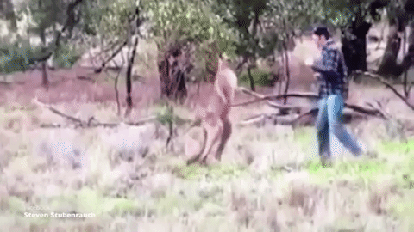
Dividing Polynomials Day 1
Get out your notes and your purple sheet and be ready for the warm-up!

Slide 2
Warm-Up
Simplify the following.
$\frac{{2x}^{3}+{2x}^{2}+12x}{6x}$ $\frac{2x^{2}−7x+6}{x−2}$

Slide 3
Example without Remainder
$$\frac{x^{3}−10x^{2}+17x+40}{x−5}$$

Slide 4
Example with Remainder
$$\frac{{2x}^{3}+15x^{2}+13x−23}{x+6}$$

Slide 5
Closure
Simplify the following.
$$\frac{{2x}^{2}+8x−60}{x+8}$$

