Slide 1
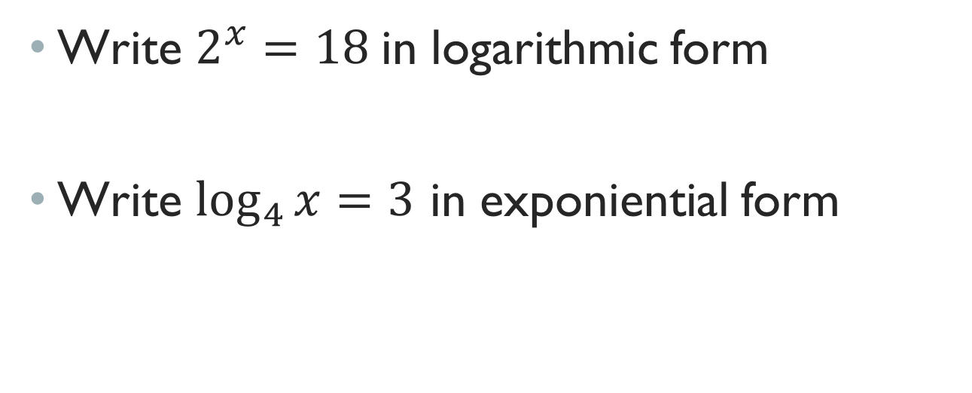
Warm UP
Write $2^{x}=18$in logarithmic form
Write $\log_{4}{x=3}$ in exponiential form
Learning Target: I will evaluate Logarithms.

Slide 2

Remember!
$base^{exponent }=answer$
$\log_{base}{answer=exponent}$
Learning Target: I will evaluate Logarithms.

Slide 3
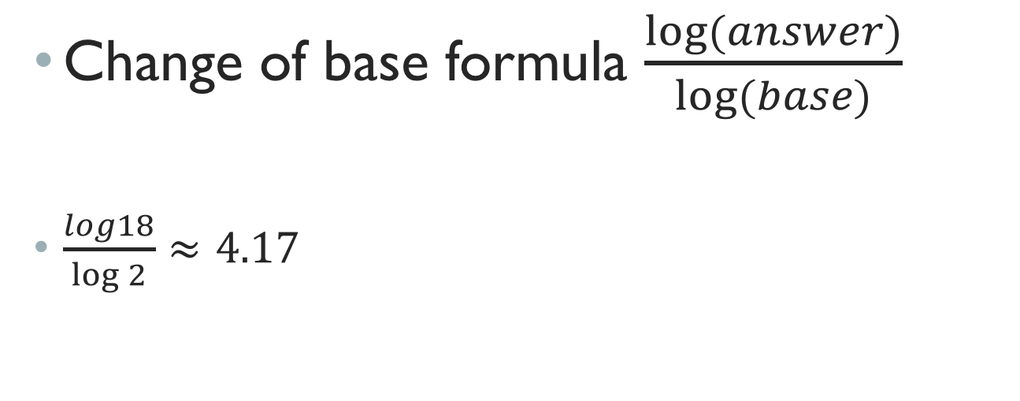
Evaluate $\log_{2}{18}$
Change of base formula $\frac{log⁡(answer)}{log⁡(base)}$
$\frac{log18}{\log{2}}≈4.17$
Learning Target: I will evaluate Logarithms.

Slide 4

Solve for x $3^{x}=44$
Rewrite in logarithmic form $\log_{3}{44=x}$
Evaluate $\frac{log44}{log3}≈3.44$
Learning Target: I will evaluate Logarithms.

Slide 5

Closure
Evaluate $\log_{5}{60}$
Solve for x. $6^{x}=23$
Learning Target: I will evaluate Logarithms.

