Slide 1
Warm Up
LT: I can solve problems using exponential growth and decay.
Solve for x.
$\log_{3}{x=5}$
$2^{x}=68$

Slide 2
Exponential Growth
LT: I can solve problems using exponential growth and decay.
$y=a{\left(1+r\right)}^{t}$
$a=starting value$
r = rate
t= time
y=total
(look for the word per)
$y=ae^{kt}$
a=starting value
e=2.71828……..
k=rate
t=time
(look for the word continuous)

Slide 3
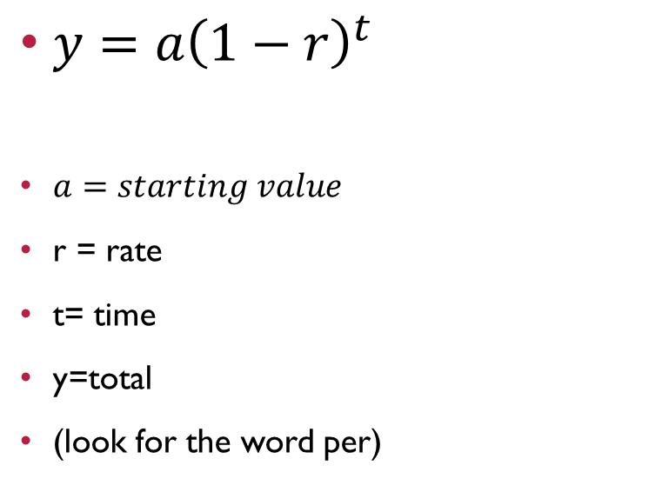
Exponential Decay
LT: I can solve problems using exponential growth and decay.
$y=a{\left(1−r\right)}^{t}$
$a=starting value$
r = rate
t= time
y=total
(look for the word per)
$y=ae^{−kt}$
a=starting value
e=2.71828……..
k=rate
t=time
(look for the word continuous)

Slide 4
Using $y=a{\left(1−r\right)}^{t}$
LT: I can solve problems using exponential growth and decay.
Each year the local country club sponsors a golf tournament. Play starts with 128 participants. During each round, 50% of the players are eliminated. How many players remain after 5 rounds?
A=128
r=.5
t=5
How many rounds until a champion is declared?

Slide 5
Using $y=ae^{kt}$
LT: I can solve problems using exponential growth and decay.
As of 2000, China was the world’s most populous country with an estimated population of 1.26 billion people. The population of China can be modeled by $C\left(t\right)=1.26e^{0.009t}$. According to this model, what is China’s population in 2017?
$a=1.26$
$k=0.009$
$t=?$

Slide 6
Closure
LT: I can solve problems using exponential growth and decay.
Using $y=a{\left(1+r\right)}^{t}$
In 1985, there were 285 cell phone subscribers in the small town of Centerville. The number of subscribers increased by 75% per year after 1985. How many cell phone subscribers were in Centerville in 2000?

