Slide 1

Warm-Up
LT: I can graph logarithmic functions.
Evaluate the following
$\log_{2}{21}$
$\log_{5}{31}$

Slide 2
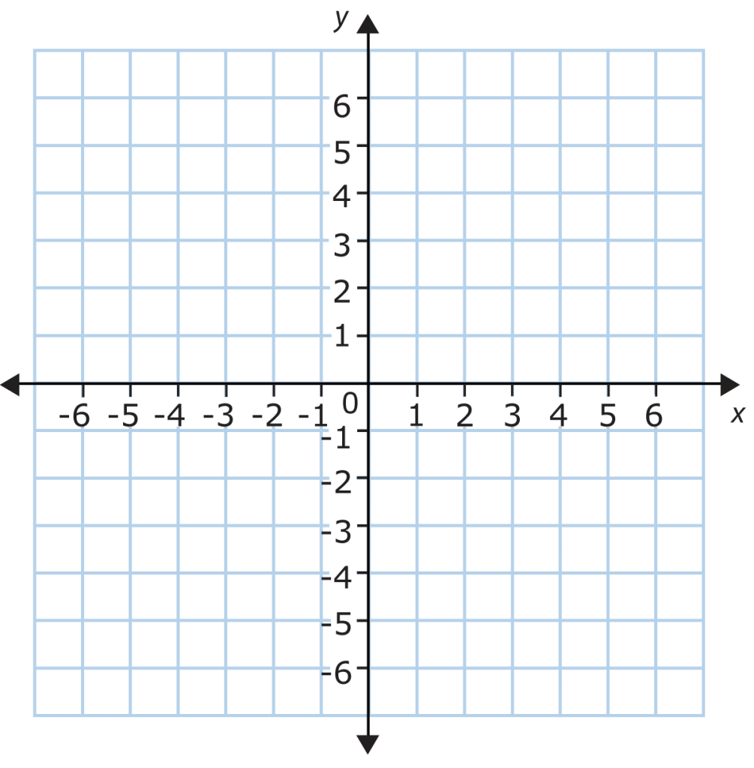
Graph $y=\log_{6}\left(x−1\right)−1$
LT: I can graph logarithmic functions.

Slide 3
Closure
Sketch the graph of $y=\log_{5}\left(x+5\right)−4$
LT: I can graph logarithmic functions.

