Slide 1

Warm-Up
LT: I can graph a polynomial.
Find all the roots.
$$2x^{3}+11x^{2}+12x=0$$

Slide 2
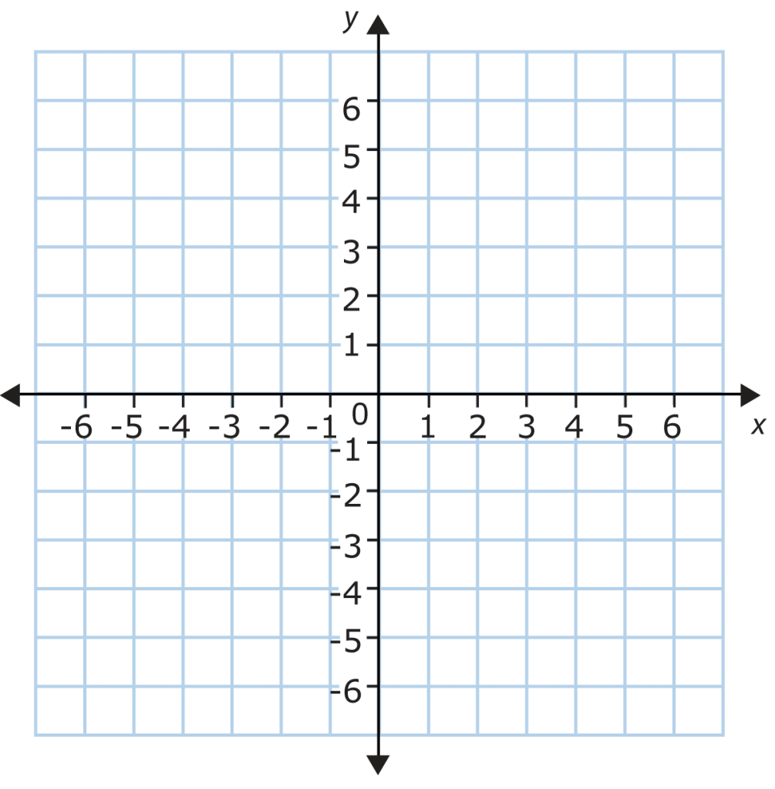
Graphing - Example
LT: I can graph a polynomial.
Sketch a graph of the following function.
$$y=x^{3}−x^{2}−6x$$

Slide 3
Closure
LT: I can graph a polynomial.
Sketch a graph of the following function.
$$y=x(3x+2)(x−4)$$

