Slide 1
Warm-Up
LT: I can graph higher order polynomials.
Find all the roots
$$2x^{4}−4x^{3}−16x^{2}=0$$

Slide 2
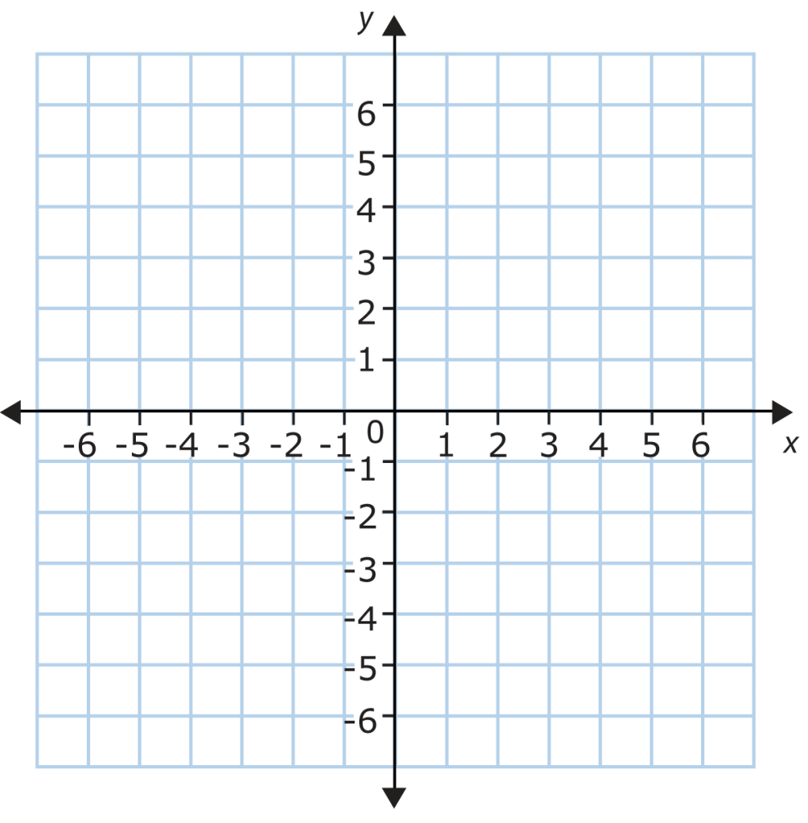
Example
LT: I can graph higher order polynomials.
Graph the function from the warm-up.
$$2x^{4}−4x^{3}−16x^{2}=0$$

Slide 3
Closure
LT: I can graph higher order polynomials.
Find the roots and determine the multiplicity of each root.
$$x(2x−1)(x+1)^{2}=0$$

