Slide 1
Warm Up:
Determine the vertex and create a table of 5 points for the function
$y=x^{2}−4x+7$

Slide 2
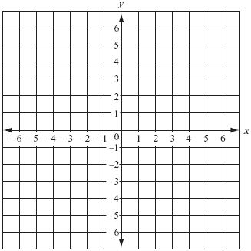
$$y>x^{2}−4x+3$$

Slide 3
Closure
Determine the vertex and create a 5 point table for the inequality:
$y≻{−x}^{2}−6x−11$

