Slide 1
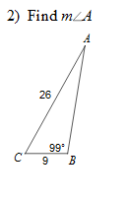
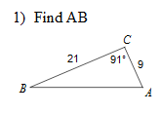
Warm UP:
Learning Target: I will graph sin and cos functions.

Slide 2
$y=a sin⁡(bθ)$ $y=a cos⁡(bθ)$
a is the amplitude
period is $\frac{360}{b}$
Sin starts at (0,0)
Cos starts at (0,1)
Learning Target: I will graph sin and cos functions.

Slide 3
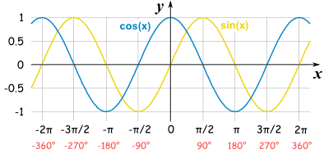
Learning Target: I will graph sin and cos functions.

Slide 4
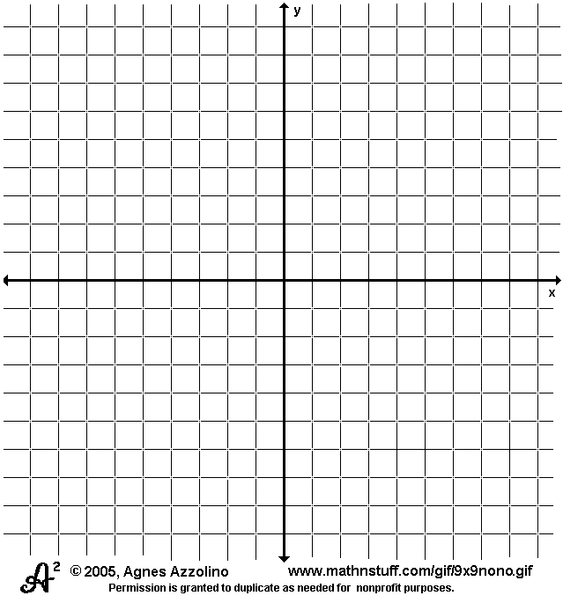
$$y=2sin3θ$$
Learning Target: I will graph sin and cos functions.

Slide 5
$$y=2 cos(4θ)$$
Learning Target: I will graph sin and cos functions.

Slide 6

Closure
Determine the period and amplitude of:
$y=5cos2θ$
$y=4cos8θ$
Learning Target: I will graph sin and cos functions.

