Slide 1
Intro to Polynomials: Exponents
Get a new purple sheet and be ready for the warm-up!

Slide 2
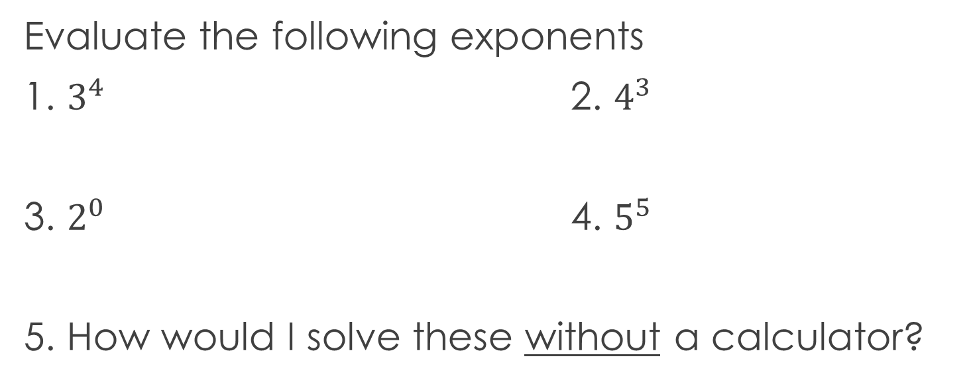
Warm-Up
Evaluate the following exponents
1. $3^{4}$ 2. $4^{3}$
3. $2^{0}$ 4. $5^{5}$
5. How would I solve these without a calculator?

Slide 3
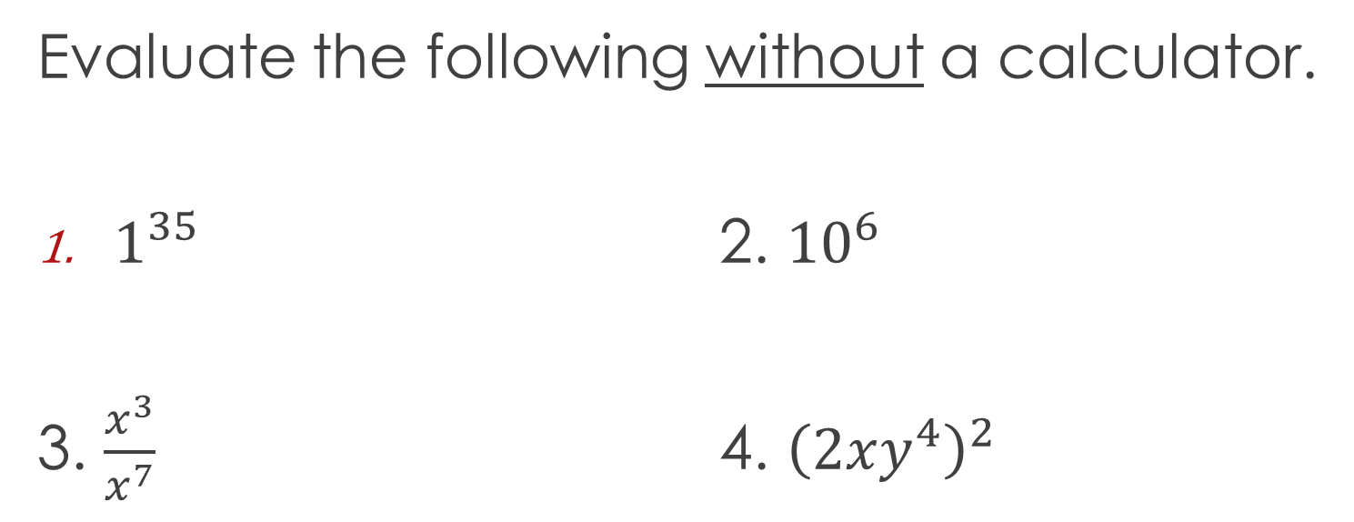
Closure
Evaluate the following without a calculator.
$1^{35}$ 2. ${10}^{6}$
3. $\frac{x^{3}}{x^{7}}$ 4. ${\left(2xy^{4}\right)}^{2}$

