Slide 1
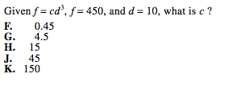
Warm Up
Learning Target: I will find the inverse of a function.

Slide 2
Determine the inverse of $f\left(x\right)=2x+3$
Learning Target: I will find the inverse of a function.

Slide 3
March Madness Practice
When you and your partner have completed a problem that you think is correct, raise your hand and I will check it.\
If it is correct, you may choose one match-up outcome on the bracket.
If it is a problem on the back of the page, you may choose two.
At the end of class, we will vote on the championship.
Learning Target: I will find the inverse of a function.

Slide 4

Closure
Learning Target: I will find the inverse of a function.
Find the inverse of $f\left(x\right)=3x−2$

