Slide 1
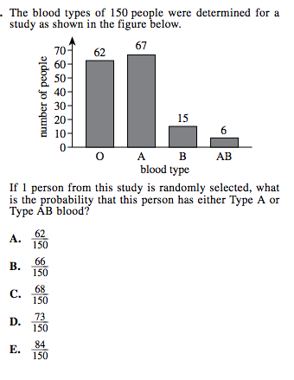
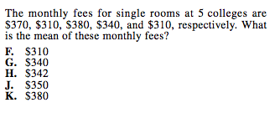
Warm up
Learning Target: I will find the inverse of a function.

Slide 2

Determine if the two functions are inverses.
$f\left(x\right)=x−2 g\left(x\right)=x+2$
Learning Target: I will find the inverse of a function.

Slide 3
Find the inverse of $f\left(x\right)=\frac{2}{3}x−3$
Learning Target: I will find the inverse of a function.

Slide 4

Closure
Learning Target: I will find the inverse of a function.
Find the inverse of $f\left(x\right)=2x−5$

