Slide 1
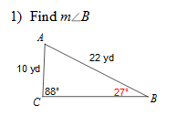
Warm-Up
LT: I can use the Law of Cosines to find missing measurements on a triangle.
$$\frac{\sin{A}}{a}=\frac{\sin{B}}{b}=\frac{\sin{C}}{c}$$
Use the Law of Sines to solve the following.

Slide 2
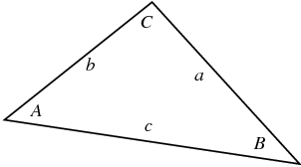
Law of Cosines
LT: I can use the Law of Cosines to find missing measurements on a triangle.
When do I use Law of Cosines
If you know:
The measure of two sides and the included angle
Or, the measure of three sides
Law of Cosines:
$$a^{2}=b^{2}+c^{2}−2bc\cos{A}$$
$$b^{2}=a^{2}+c^{2}−2ac\cos{B}$$
$$c^{2}=a^{2}+b^{2}−2ab\cos{C}$$

Slide 3
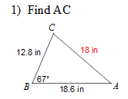
Law of Cosines Example
LT: I can use the Law of Cosines to find missing measurements on a triangle.

Slide 4
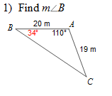
Missing Angle Cosine Example
LT: I can use the Law of Cosines to find missing measurements on a triangle.

Slide 5
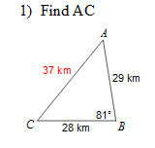
Closure
LT: I can use the Law of Cosines to find missing measurements on a triangle.

