Slide 1
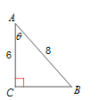
Warm-Up
LT: I can use the Law of Sines to find missing measurements on a triangle.
Find the missing information.

Slide 2
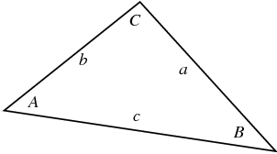
Law of Sines
LT: I can use the Law of Sines to find missing measurements on a triangle.
When do I use the Law of Sines
If you know:
The measures of two angles and any side
Or, the measure of two sides and the angle opposite one of them.
Law of Sines:
$$\frac{\sin{A}}{a}=\frac{\sin{B}}{b}=\frac{\sin{C}}{c}$$

Slide 3
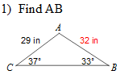
Law of Sines Example
LT: I can use the Law of Sines to find missing measurements on a triangle.

Slide 4
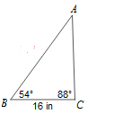
Closure
LT: I can use the Law of Sines to find missing measurements on a triangle.
Find the missing side.
Find AB

