Slide 1
Monomials
Get out your Purple Sheet and be ready for the Warm-Up

Slide 2

Warm-Up
Simplify the following.
1. ${(3x^{2})}^{3}$ 2. $\frac{x^{3}y^{6}}{x^{4}y^{5}}$
3. ${3x}^{−4}$ 4. ${(2x^{4}∙3x^{3})}^{0}$

Slide 3
Multiplying Powers
Complete the first 5 problems (1-5) using the rule for multiplying powers.
You have about 5 minutes.
Please do not move on until I instruct you to do so.

Slide 4
Raising a Product to a Power
Complete the next 5 problems (6-10) using the rule for raising a product to a power.
You have about 5 minutes.
Please do not move on until I instruct you to do so.

Slide 5
Division of Powers
Complete the next 5 problems (11-15) using the rule for division of powers.
You have about 5 minutes.
Please do not move on until I instruct you to do so.

Slide 6
Negative Exponents
Complete the next 5 problems (16-20) using the rule for negative exponents.
You have about 5 minutes.
Please do not move on until I instruct you to do so.

Slide 7
Misc.
Complete the last 5 problems (21-25) using all t he rules we have learned so far.
You have about 5 minutes.

Slide 8
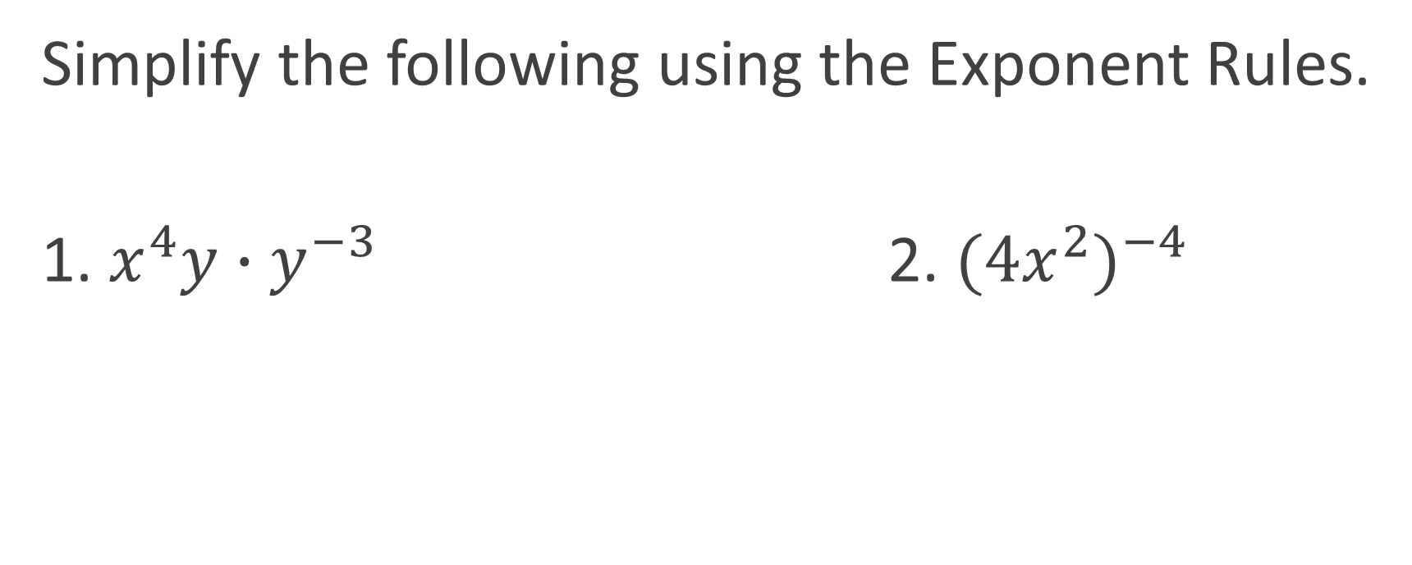
Closure
Simplify the following using the Exponent Rules.
1. $x^{4}y∙y^{−3}$ 2. ${{(4x}^{2})}^{−4}$

