Slide 1

Warm Up:
$f\left(x\right)=x+2 g\left(x\right)=3x−4$
Find $\left(g∙f\right)\left(x\right)$
Find $(g∘f)(x)$
Learning target: I will simplify operations of functions.

Slide 2
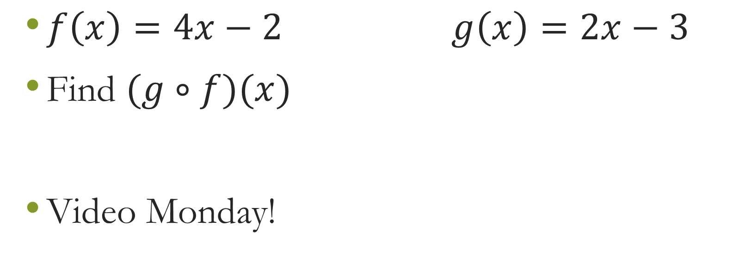
Closure
$f\left(x\right)=4x−2 g\left(x\right)=2x−3$
Find $(g∘f)(x)$
Video Monday!
Learning target: I will simplify operations of functions.

