Slide 1
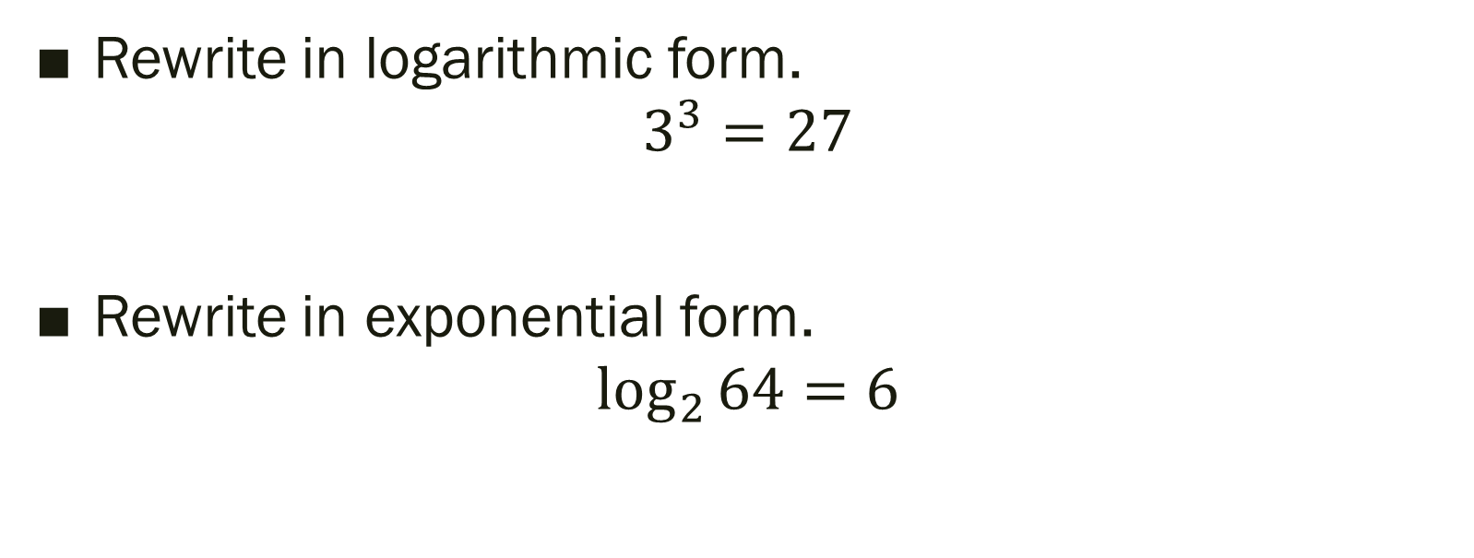
Warm Up
LT: I can rewrite logarithmic equations using the properties of logarithms.
Rewrite in logarithmic form.
$$3^{3}=27$$
Rewrite in exponential form.
$$\log_{2}{64=6}$$

Slide 2
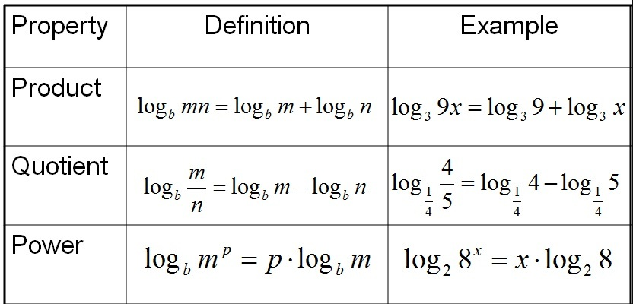
Properties of Logs
LT: I can rewrite logarithmic equations using the properties of logarithms.
*Note: Bases of the logarithms must be the same!

Slide 3
Expand $\log_{7}{\frac{5^{3}}{3^{4}}}$
LT: I can rewrite logarithmic equations using the properties of logarithms.

Slide 4
Condense ${5log}_{5}{12}+30\log_{5}{7}$
LT: I can rewrite logarithmic equations using the properties of logarithms.

Slide 5

Closure
LT: I can rewrite logarithmic equations using the properties of logarithms.
Expand the following.
$$\log_{8}{(6∗11∗5^{4})}$$

