Slide 1

Warm Up
LT: I can rewrite logarithmic equations using the properties of logarithms.
Expand the following logarithm.
$$\log_{9}{{\left(\frac{a^{3}}{b}\right)}^{4}}$$

Slide 2
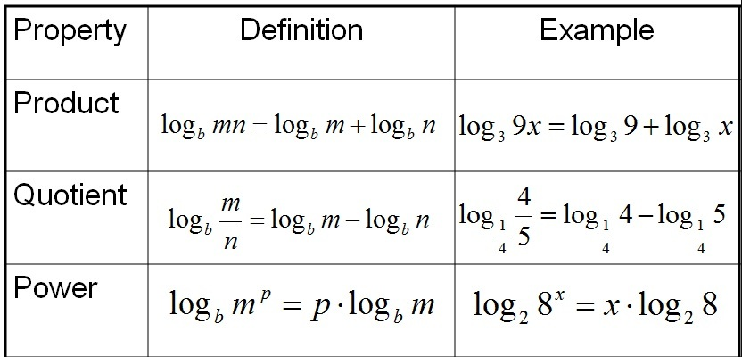
Properties of Logs
LT: I can rewrite logarithmic equations using the properties of logarithms.

Slide 3
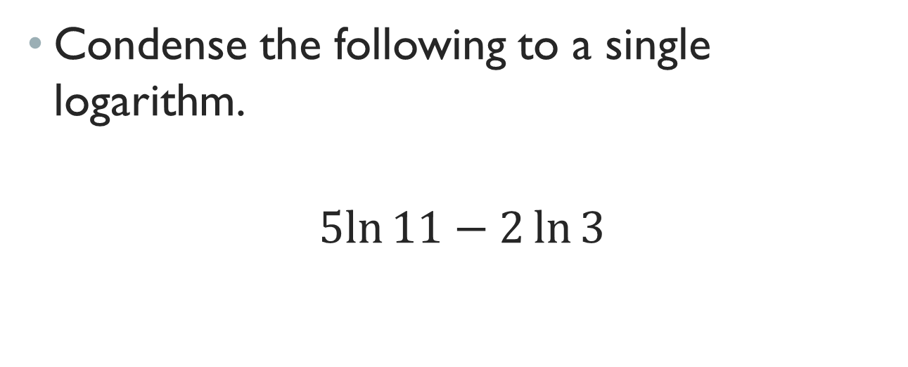
Closure
LT: I can rewrite logarithmic equations using the properties of logarithms.
Condense the following to a single logarithm.
$$5ln{11}−2\ln{3}$$

