Slide 1
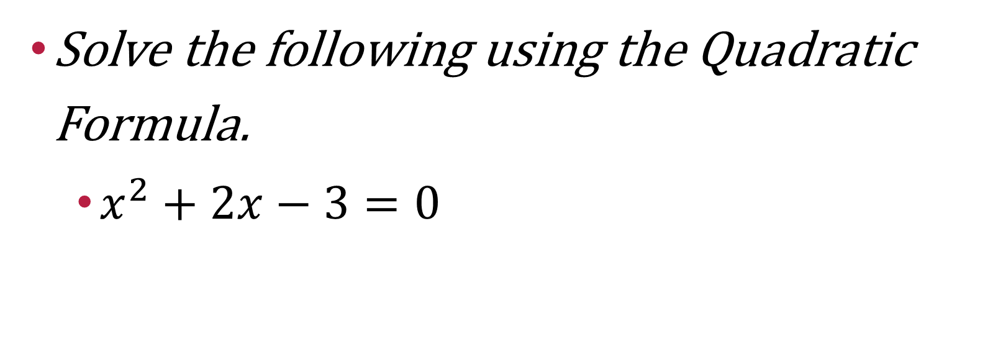
Warm up
Solve the following using the Quadratic Formula.
$x^{2}+2x−3=0$

Slide 2
$$x=\frac{−b±\sqrt{b^{2}−4ac}}{2a}$$
$ax^{2}+bx+c=0$
MUST BE EQUAL TO 0
If a term is missing then the corresponding letter is 0

Slide 3
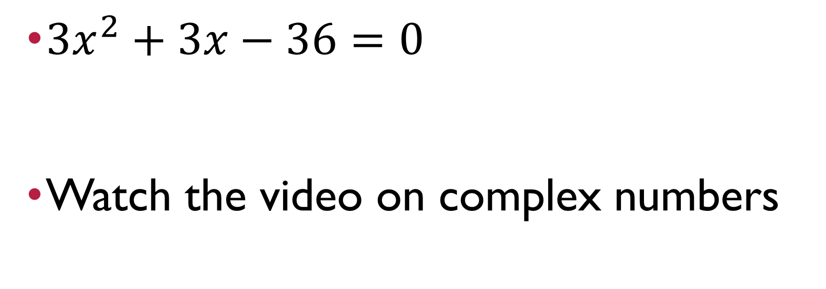
Closure
$3x^{2}+3x−36=0$
Watch the video on complex numbers

