Slide 1
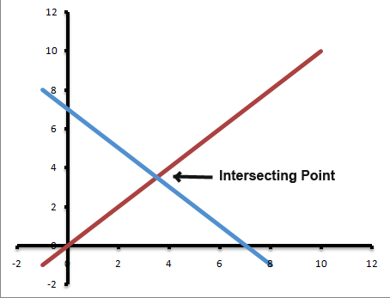
Warm Up:
Find the Solution to the systems:

Slide 2
Solving Systems of equations by graphing
Step one: BOTH equations should be in y=mx+b form
Step two: graph BOTH equations
Step three: locate intersection point
Step four: Check the solution!

Slide 3
Example y=1/2x-2 2y=-4x+6
Step one: y=mx+b
y=1/2x-2
2y=-4x+6
÷2 ÷2
y=-2x+3

Slide 4
Graph y=1/2x-2 y=-2x+3

Slide 5
Intersection point
(2,-1)
Check point (2,-1) in BOTH equations
-1=1/2(2)-2 2(-1)=-4(2)+6
-1=1-2 -2=-8+6
-1=-1 -2=-2

Slide 6
Solve: y-2=4x y=2x
Step one: y=mx+b
y-2=4x
+2 +2
y=4x+2

Slide 7
Graph: y=2x y=4x+2

Slide 8
Intersection point
(-1,-2)
CHECK!
(-2)-2=4(-1) -2=2(-1)
-4=-4 -2=-2

Slide 9
Reminder!
Parrallel Lines NEVER cross, there is NO SOLUTION
Two lines with the same slope AND the same y-intercept have infinite crossing points, they have INFINITE SOLUTIONS!

Slide 10
Activity
Make sure you are write the intersection point of each line and CHECK your answer

Slide 11
Closure:
Determine the solution to
y=2x-4
2y=2x-4

