Slide 1
Warm Up:
Solve the system of inequality:
$$\left\{\begin{aligned}y≻−3x+5 \\ y≤x−2\end{aligned}\right.$$

Slide 2
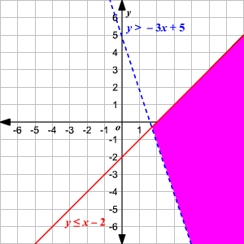
Solution

