Slide 1
4.8 Solving Systems with Matrices Day 3
Get out your “Purple” Sheets and be ready for a warm-up!

Slide 2
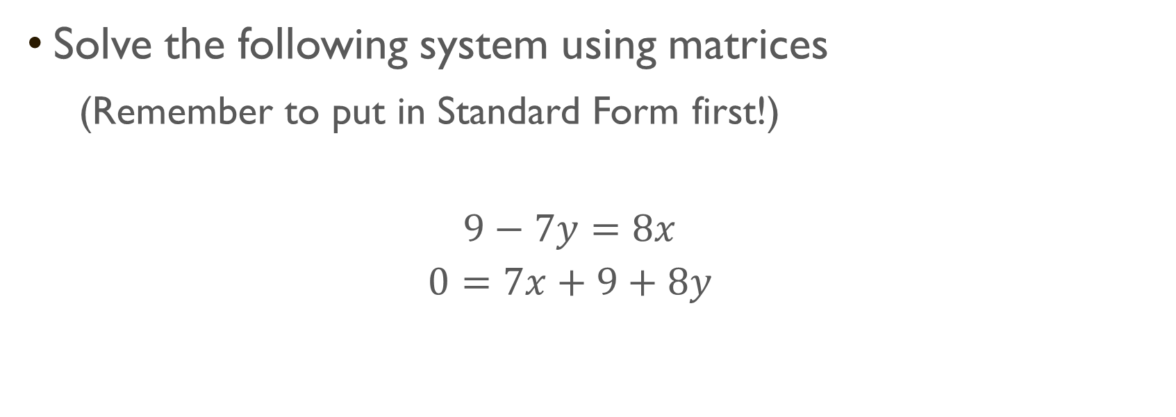
Warm-Up
Solve the following system using matrices
(Remember to put in Standard Form first!)
$$9−7y=8x$$
$$0=7x+9+8y$$

Slide 3

Example of System with 3 Variables
Solve the system using matrices.
$$5x+5y+6z=5$$
$$4x+6y−z=10$$
$$−3x+6y+2z=24$$
$$(−2, 3, 0)$$

Slide 4

Closure
Solve the system using matrices.
$$5x+3y+3z=−18$$
$$−3x+6y+2z=3$$
$$−2x+4y+3z=2$$

